Slide 1

Accrol Group Holdings Plc
Results Presentation FY19
September 2019

Slide 2
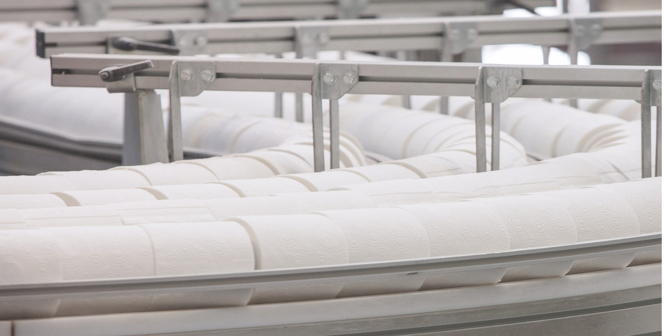
FOUNDATIONS LAID FOR
SUSTAINABLE GROWTH
-29%
COST BASE
REDUCTION
+64%
OUTPUT PER
HEAD
+12%
TOILET TISSUE
REVENUE
+£6.8M
ADJUSTED
EBITDA GROWTH
+£10.8M
HEADWINDS
MANAGED

Slide 3

CONTINUED IMPROVEMENTS
+4%
*GROSS
MARGIN
-£6.7m
NET DEBT
REDUCED
+1%
CORE
REVENUE
-£17.6m
COST BASE
REDUCTION
FY20
GUIDANCE
UNCHANGED
* Adjusted gross margin moved from 17.5% to 18.2%

Slide 4
THE MOST COMPLEX
TURNAROUND: DELIVERED
The downturn
The turnaround
Simplification
Streamlining
Operational
efficiency
Scale & Growth
Future
developments
We are here
Cost base
Exited
Skelmersdale
Net Debt reduced by £6.7m
Exiting
Logistics
warehousing
Reduction of raw materials and finished goods
Improved controls, releases space improves cash
Industry leading team in place
Leadership team right for growth
Simplification
People
589 to 340
Commissioned new £4m line in Leyland
Improved efficiency and capacity
SKU
460 to 120
Fundraising and new bank facility
Created cash headroom and time
Cost base
Reduced by £17.6m
Material types
75 to 20
Platform for growth
New Board and team build begins
World class team to build for the future
Production lines
18 to 10
EBITDA
Automation
Head count reduction
2017
2018
2019

Slide 5
The turnaround costs
 | Cost of sales £’000 | Administration £’000 | 2019 Total £’000
Turnaround costs | 3,756 | 3,452 | 7,208
A – Management reorganisation and restructure | - | 724 | 724
B – Skelmersdale exit | 605 | 2,569 | 3,174
C – Operational reorganisation and restructure | 854 | 18 | 872
D – Raw material and finished goods stock waste | 2,298 | 10 | 2,308
E – Impairment of property and equipment | - | 130 | 130
Other non-recurring financial instruments | 408 | 290 | 698
F – Loss on derivative financial instruments | - | - | -
G - other | 408 | 290 | 698
Total “turnaround costs” | 4,164 | 3,742 | 7,906
“Accrol is now a fundamentally different
organisation, operationally, to that which
floated on AIM in June 2016. Every part
of the organisation has been restructured
or changed in some way, since February
2018.”
It now has the right
foundation to
grow strongly

Slide 6
A YEAR OF GREAT CHANGE
OUR BUSINESS
340 42%
Employees
Reduction driven by business
simplification and increased
Automation (589 to 340 like for like)
4 20%
Sites
Closure of the Skelmersdale
distribution centre
27 73%
Core Customers
Simplification as we exited none
profitable customers and the
AFH sector
120 74%
Stock Keeping Units (SKUs)
Simplification of the business
Customers
Small profit achieved before
charging £7.9m of turnaround
costs
Before charging £12.9m
of exceptional costs
Representing the low point of the
turnaround cycle as issues
identified and plans developed
Against foreign exchange and
paper price headwinds of £13.2m
Operational efficiency
& cost control

Slide 7
Cash and debt
“Our goal in the mid-term is to return the business to satisfactory profitability levels and normalised debt. It remains the Board’s intention to return to the dividend list at the earliest appropriate opportunity”
FY19/FY18
Financial results
 | FY 19 | FY 18 | Target
Revenue Core revenue | £119.1m £116.3m | £139.7m £115.2m | Grow ahead of the market
Adjusted EBITDA | £1.0m | (£5.8m)
Net debt | £27.1m | £33.8m
EBITDA % Sales | 0.9% | -4.2% | >10%
Net debt/EBITDA | 27.1x | -5.8x | <2x
Credit facility

Slide 8
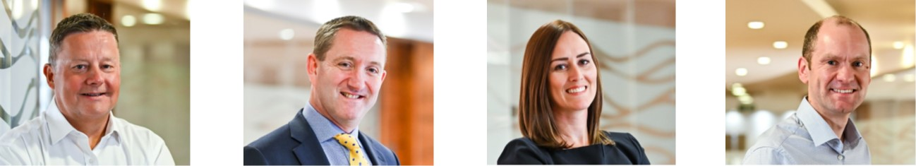
People Make the Difference
“Industry leading team now in place”
“I help Accrol turn our vision into reality in
terms of our people, our equipment and our
product offering.”
Mark Dewhurst
Chief Operating Officer
Previous Experience
Ten years at DS Smith as UK
& Northern Europe Operations Director.
Ten years with Crown Packaging in senior
Operational & Commercial roles.
Extensive operational leadership driving
manufacturing excellence across multiple
businesses.
An inspirational leader of people and
businesses, who understand the
complexity of driving strategy throughout
organisations at every level.
A hands on leader who has delivered
significant EBITDA improvements over
the last six years.
“I am passionate about maximising the
potential of our people to deliver profitable
growth through setting aspiration targets in
both operational and commercial
Graham Cox
Commercial Director
Previous Experience
24 years at DS Smith PLC covering sales,
commercial and operations. Last two years
as Managing Director, North America
Packaging Division.
Previous three years as Sector Director
UK Packaging.
Extensive experience in delivering industry
leading levels of return, personally leading
commercial improvement programmes
delivering significant margin improvements.
Delivered industry leading EBITDA
improvements over the last six years.
“Engagement across the workforce has
significantly improved following the completion
of the turnaround – and the teams throughout
our organisation remain key”
Kathryn Robinson
HR Director
Previous Experience
11 years spent in private label manufacturing
supplying the UK Grocery Sector.
9 years BBF Ltd
(previously McCambridge Group)
4 & 2 years at Sodexo Healthcare and
Alfred McAlpine respectively.
A dynamic individual with a clear understanding
of how people at all levels with in an
organisation make a difference to the
success of the wider business.
“With the tough job of turnaround behind us,
I look forward to championing the continuous
improvement culture throughout the
organisation”
John Pilkington
Finance Director
Previous Experience
ACA, trained at KPMG
14 years at technology company Promethean
leading teams through complex and challenging
reporting environments giving clarity to the key
drivers of a manufacturing business.
Supports operational leaders and teams to make
good commercial decisions as transformational
change happens at a rapid pace.
An excellent understanding of the business
and great fit with the team.

Slide 9
COMMITTED TO SUPERIOR
PERFORMANCE
5
Lost time accidents
30% reduction on prior year
48% reduction in All accidents
15% reduction in near misses
75%
Employee Engagement
74% feel that management support them in their roles
64% of employees feel there
are opportunities to grow
86% feel they have everything they need to full fil their roles
72% feel there is a clear common goal
64%
Increase in Output per head
42% reduction in head count on a like for like basis
£5m investment in machinery and simple automation
£0.8m invested in training throughout the operational workforce
THE RIGHT
PEOPLE
STRONG CUSTOMER RELATIONSHIP
96%
On time delivery
Percentage of deliveries on time and in full over a calendar months
12%
Toilet Tissue Growth
Represents 70% of our total revenue
Up from 11% growth FY18
22%
Growth with top customers
No one customer equates to more than 20% of our total revenues
GENERATE SHAREHOLDER RETURNS
Down £6.7m
Net Debt
Down £6.7m to £27.1m
£1.0m
Adjusted EBITDA
An improvement of £6.8m on FY18
up 4%
Adjusted Gross Margin
Up to 18.2% from 17.5%

Slide 10
STRONG POTENTIAL WITH A
CONFIDENT MARKET SHARE
Private Label
Branded Products
Total UK soft tissue market
£1.59 billion
(2018: £1.54bn)
2.8%
Toilet Tissue
Kitchen Towel
Accrol
24%
Largest Independent supplier growing at 12% (Toilet Tissue)
Largest range of customers (27 core customers)
Market grows at 8% per year
Market insight
First to offer a plastic free range
Accrol market share
Private Label penetration
Total UK market

Slide 11
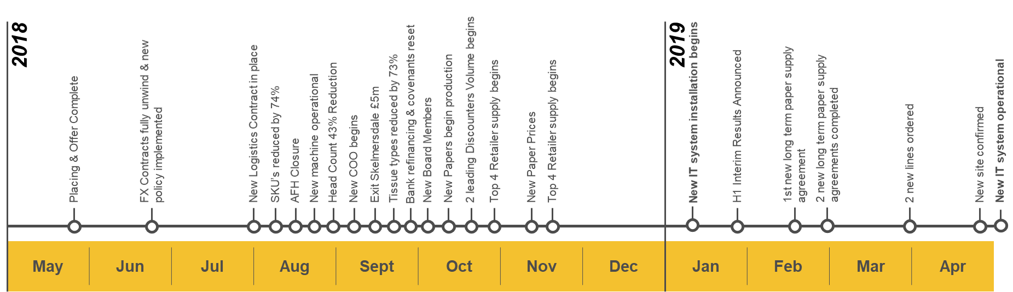
Our progress
“The turnaround work is behind us”
Timeline
2019
2020
Automation programme begins
New IT system in place
New machine operational
First phase automation completed
Logistics tender
Sep | Oct | Nov | Dec | Jan | Feb | Mar | Apr | May | Jun | Jul | Aug
Right people
Right roles
Quality, service, innovation
Delight our customers
Relentless on costs
Consistent returns

Slide 12
Disclaimer
This presentation is for information purposes only and no reliance may be placed upon it. No representation or warranty, either expressed or implied, is provided in relation to the accuracy, completeness or reliability of the information contained in this presentation.
This presentation does not constitute or form part of any offer or invitation for sale or subscription of, or any solicitation of any offer to buy or subscribe for, any securities of Accrol Group Holdings plc. The making of this presentation does not constitute a recommendation regarding any such securities.
This presentation contains certain forward-looking statements. Any statement in this presentation that is not a statement of historical fact including, without limitation, those regarding Accrol Group Holding plc’s future business, financial condition, financial performance, operations, prospects or developments is a forward-looking statement. These forward-looking statements can be identified by the use of forward-looking terminology, including the terms "anticipates", "believes", "envisages", "estimates", "expects", "intends", "hopes", "may", "plans", "targets", "will", "would", "could" or "should" or, in each case, the negative of those, variations or comparable expressions. By their nature, forward-looking statements involve risk and uncertainty as they relate to events which occur in the future. No representation or warranty is made that any of these statements or forecasts will come to pass or that any forecast results will be achieved. Actual performance or results may differ materially from any future results, performance or achievement expressed or implied by these forward-looking statements. Factors which may give rise to such differences include (but are not limited to) changing business conditions, introduction of competing products by other companies, and changing economic, legal or regulatory conditions. New factors could emerge that could cause Accrol Group Holding plc’s business not to develop as it expects. These and other factors could adversely affect the outcome and financial effects of the events specified in this presentation. The forward-looking statements are made by the Directors of Accrol Group Holding plc in good faith based on the information available to them at 1 September 2019 and reflect the Directors’ knowledge and information available at that date and their beliefs and expectations. Accrol Group Holding plc does not intend to update any forward-looking statements contained in this presentation. Each forward-looking statement speaks only as at 1 September 2019 and Accrol Group Holding plc and its advisers expressly disclaim any obligations or undertaking to release any update of, or revisions to, any forward-looking statements in this presentation. No statement in the presentation is intended to be, or intended to be construed as, a profit forecast or profit estimate and no statement in the presentation should be interpreted to mean that earnings per Accrol Group Holding plc share for the current or future financial years will necessarily match or exceed the historical earnings per Accrol Group Holding plc share. As a result, you are cautioned not to place any undue reliance on such forward-looking statements. Past performance of securities in Accrol Group Holding plc cannot be relied upon as a guide to the future performance of such securities.
The content of this promotion has not been approved by an authorised person within the meaning of the Financial Services and Markets Act 2000. Reliance on this promotion for the purpose of engaging in any investment activity may expose an individual to a significant risk of losing all of the property or other assets invested

